Slide 1
Cubit State Management
Prepared by Nour Eldin Hesham

Slide 2
Agenda
01 Introduction to State Management
02 Introduction to Bloc
03 Cubit
04 Let’s code

Slide 3
01
Introduction

Slide 4
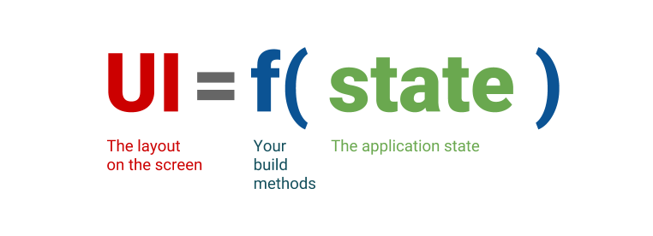
What’s State?
State refers to the data that can change over time within an application. In Flutter, the state is what the UI represents at any moment.
Flutter apps use a declarative UI programming model to build user interfaces. In a declarative model, the UI is built by describing the current state of the UI based on the app's state.
Widget define their UI by Overriding the build() Method Function that convert the state into UI
Notes:
Everything in Flutter is a widget. Widgets describe what the UI should look like given the current state and configuration.

Slide 5
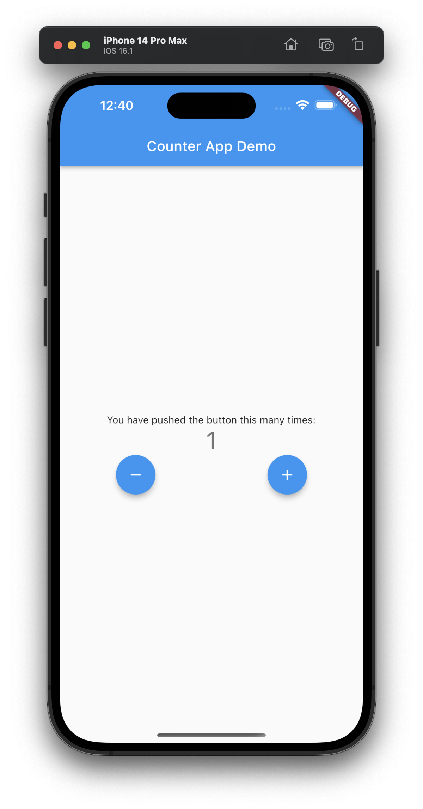
State Types
Temporary state
Also known as UI state, is a short-lived state that does not need to persist beyond the current session or component lifecycle. It's typically managed using local state management solutions like StatefulWidget or state management libraries that handle local state.

Slide 6
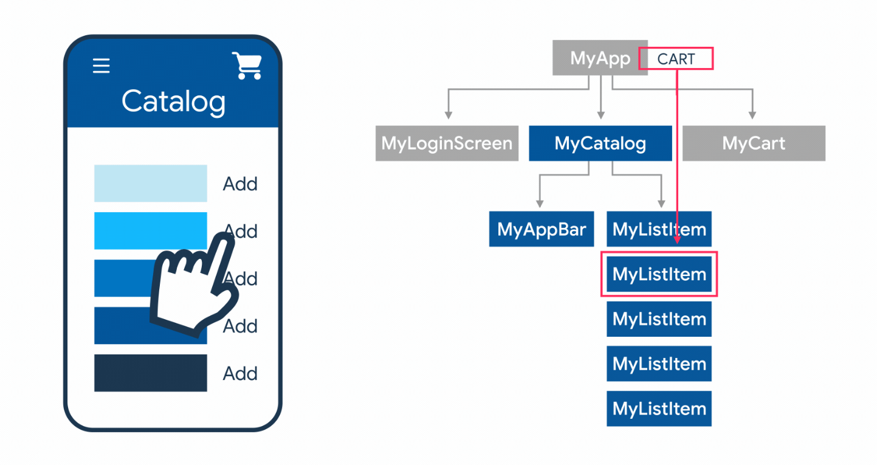
State Types
App State
Represents the overall state of the application. It includes the state that must be shared across multiple app parts, such as user authentication status, theme settings, and other global settings.

Slide 7
Stateless vs Stateful widgets
Stateless
Stateful
A widget that does not have any mutable state (immutable).
Always renders the same way given the same configuration.
A widget that has a mutable state.
Can change its appearance in response to events or user interactions.
Calling setState() causes a rebuild of the widget, changing the UI when the state data changes.

Slide 8
What’s State Management?
State management is the process of handling the state of an application.
It involves managing how an application’s data (state) changes over time and how the UI reflects these changes.
Enable us to understand our program.

Slide 9
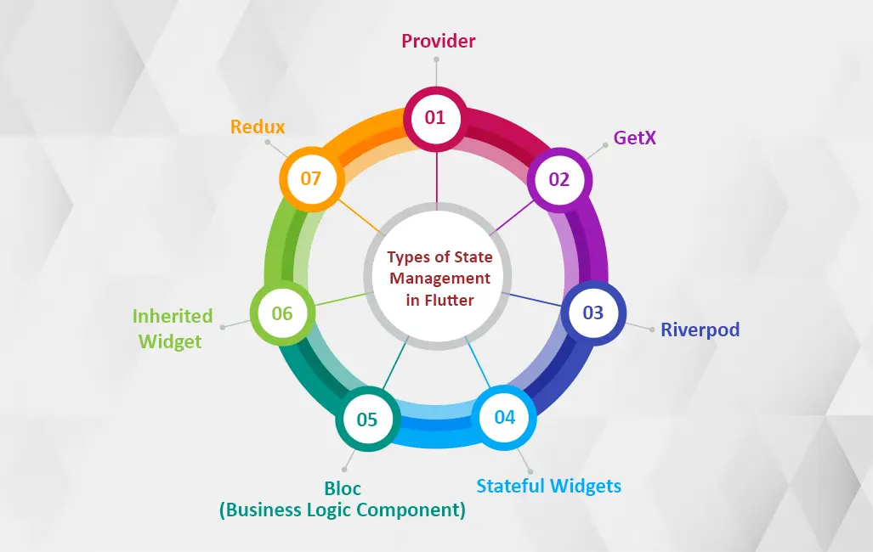
Popular State Management Solutions

Slide 10
02
BLoC

Slide 11
BLoC StateManagment
BLoC stands for business logic components and is a design pattern introduced by Google in 2018.
The BLoC pattern is a methodology designed to manage state and business logic in Flutter applications. It helps separate the presentation layer from business logic and manages the state by reacting to incoming events.
In Flutter, implementing the BLoC pattern involves using specific Flutter BLoC library components, like BlocBuilder and BlocProvider, to connect the UI with the BLoC logic.

Slide 12
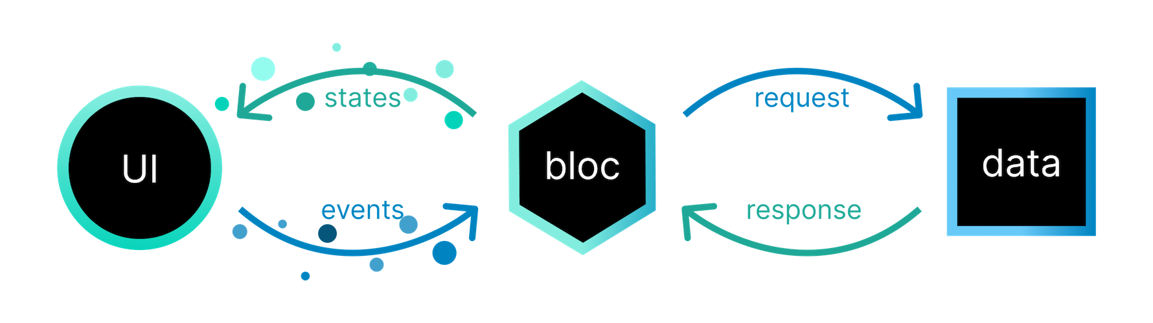
BLoC Architecture

Slide 13
BLoC Components
BLoCProvider :
A Flutter widget that provides a bloc to its subtree. This is a convenient way to make the bloc available to multiple widgets.
It provides an easy way to access the Bloc or Cubit instance from any descendant widget using the BlocProvider.of<T>(context)

Slide 14
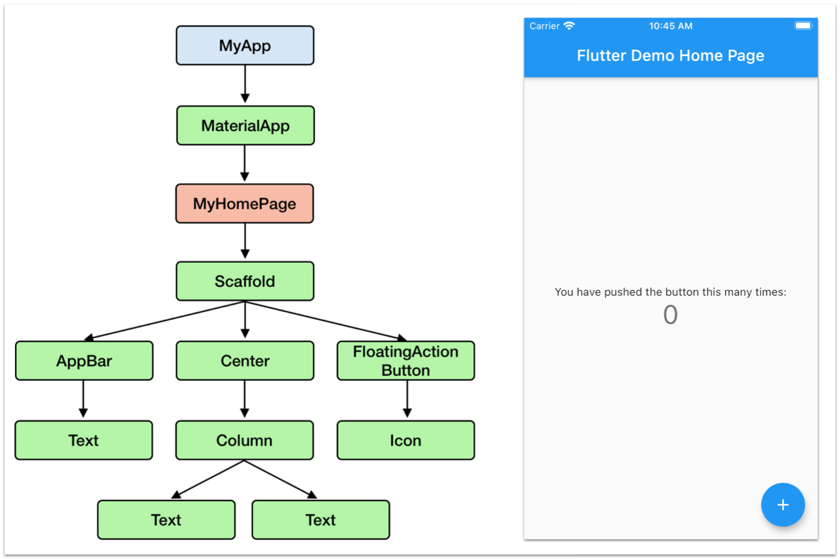

Slide 15
BLoCBuilder :
A Flutter widget that helps rebuild parts of the UI in response to new states.
BLoCListener :
A Flutter widget that listens to state changes in the bloc and executes side effects (e.g., showing a snack bar).
BlocConsumer :
A combination of BlocBuilder and BlocListener, allows you to rebuild the UI and handle side effects in one widget.
MultiBlocProvider, MultiBlocListener :
Utilities to provide multiple blocs or listeners in a clean way.

Slide 16
03
Cubit

Slide 17
Cubit StateManagment
Cubit is a state management solution in Flutter, provided by the bloc package. It is a lightweight alternative to the more complex Bloc class, providing a more straightforward approach to handling state changes.
Use Cubit when you need straightforward state management without the overhead of handling events.

Slide 18
Cubit vs BLoC
Cubit
BLoC
For straightforward screens with minimal logic, Cubit's lightweight approach shines.
For beginners, Cubit's gentler curve eases them into state management concepts.
When intricate UIs with numerous events unfold, BLoC's strict structure provides clarity and control.
For large projects with potential growth, BLoC's well-defined architecture adapts effectively

Slide 19
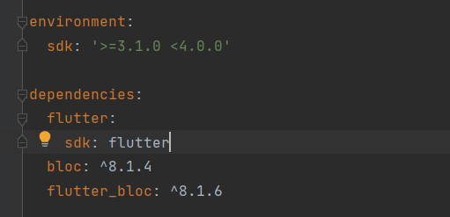
Getting Started
To begin using Bloc in a Flutter project, developers need to include the bloc and flutterbloc package as a dependency in their project's pubspec.yaml file.
Notes:
bloc Package -> contains the fundamental building blocks for implementing the BLoC pattern, such as Bloc, Cubit, and various utilities for handling state and events.
flutter_bloc Package -> Components: BlocProvider, MultiBlocProvider, MultiBlocListener.

Slide 20
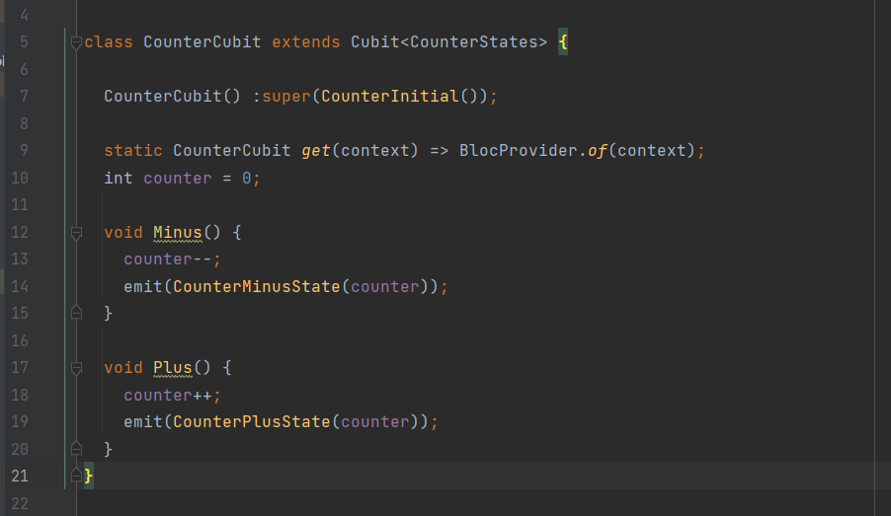
The first step will be to create a Cubit Class: It manages the state of our app.
Notes:
The angle brackets <> in class CounterCubit extends Cubit<CounterStates> are used to specify the generic type parameter. In this context, Cubit<CounterStates> means that the CounterCubit class extends the Cubit class with CounterStates as its state type.

Slide 21
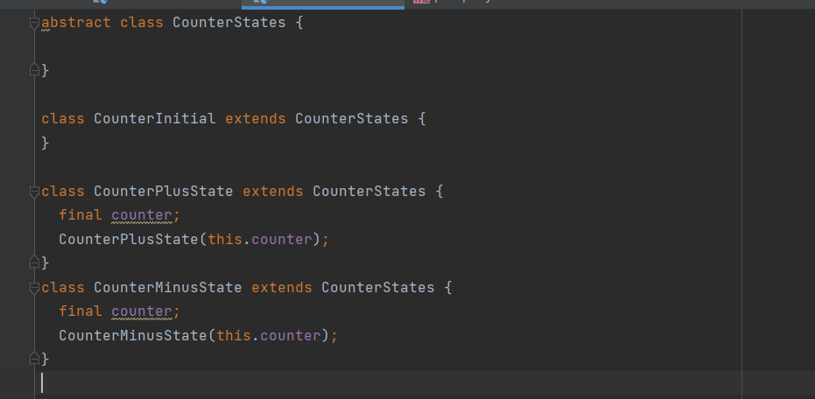
The second step will be to create an App states class: is used to represent the different states that the Cubit can be in.
Notes:
Abstract class CounterStates -> This serves as the base class for all specific states related to the counter and theme. It provides a common type for all state classes.
These classes inherit from CounterStates and represent different possible states of the application. Each class holds relevant data for that particular state.

Slide 22
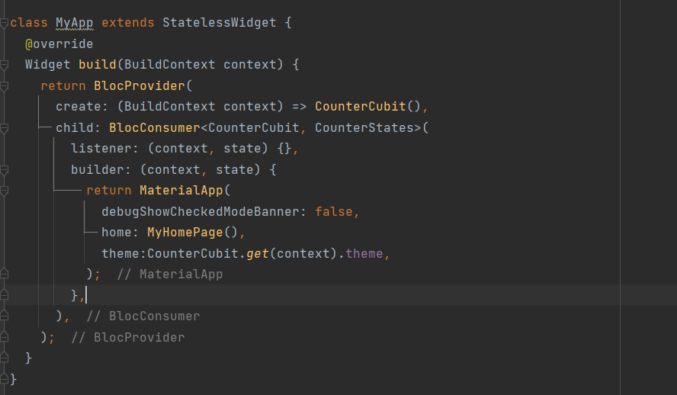
What’s Next?
Don’t forget that to use the Cubit, we must first provide it using BlocProvider ( Also Known as the dependency injection widget).
Notes:
create: (BuildContext context) => CounterCubit() is used to create and provide an instance of CounterCubit within a specific part of the widget tree. This is a common pattern in state management libraries like provider and flutter_bloc.
Example With Cascade Operator
AppCubit()..createDatabase()
Example Without Cascade Operator
AppCubit cubit = AppCubit();
cubit.createDatabase();
create: (BuildContext context) {
AppCubit appCubit = AppCubit();
appCubit.createDatabase();
return appCubit;
},

Slide 23
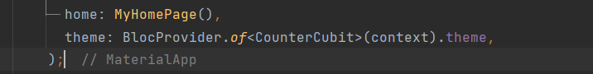
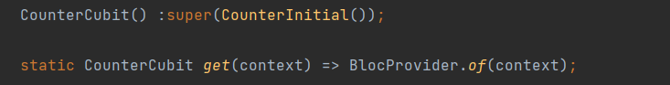
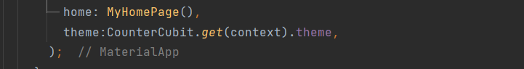
To retrieve the nearest instance of a provided object in the widget tree, you typically use one of the following methods in Flutter:
Notes:
The method returns an instance of CounterCubit
get(context) -> It simplifies the retrieval of the AppCubit instance in the widget tree. Instead of writing BlocProvider.of<AppCubit>(context) everywhere in your code, you can just call AppCubit.get(context).

Slide 24
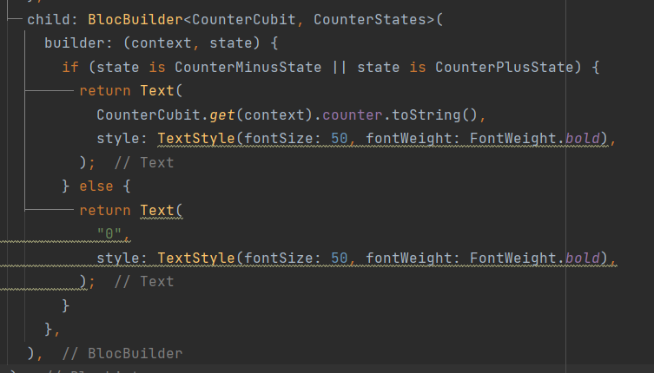
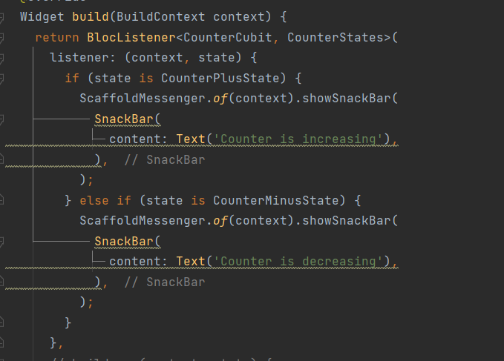
BlocBuilder vs BlocListener
BlocBuilder
BlocListener

Slide 25
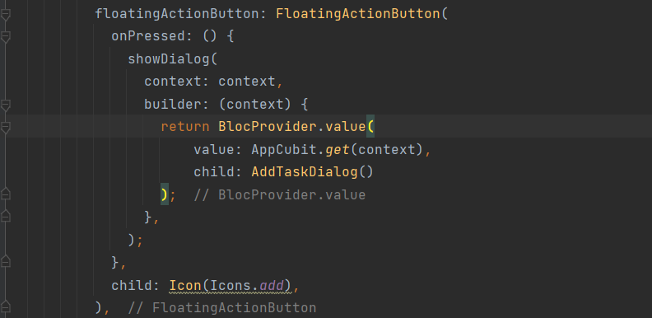
In some cases, we need to pass the BlocProvider instance to another widget tree to ensure that the new subtree has access to the same bloc or cubit instance used in the rest of the app.
Notes:
When opening a dialog, the new widget subtree created by the dialog might not have access to the dependencies provided in the main widget tree. To address this, we pass the BlocProvider instance to the new subtree.

Slide 26
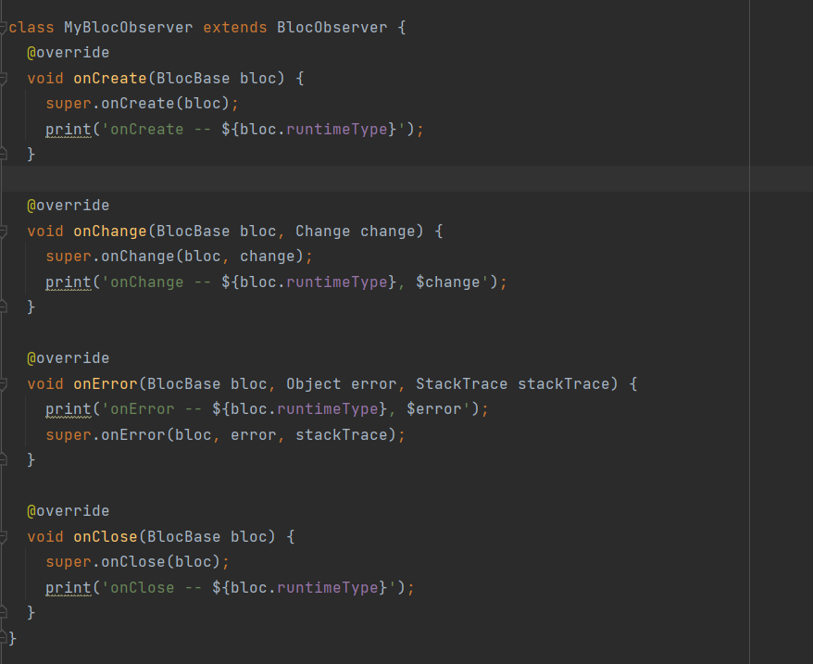
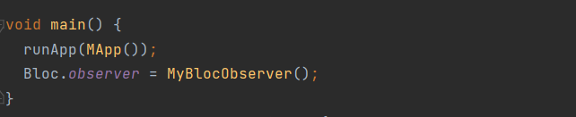
Observing a Cubit
This class extends BlocObserver and overrides its methods to provide custom behavior for different lifecycle events of Bloc and Cubit instances.

Slide 27
Resources
https://www.dhiwise.com/post/flutter-bloc-tutorial-understanding-state-management
https://www.kodeco.com/books/real-world-flutter-by-tutorials/v1.0/chapters/3-managing-state-with-cubits-the-bloc-library
https://theonetechnologies.com/blog/post/mastering-state-management-in-flutter-a-comprehensive-guide#stateful-widgets
https://createthrive.com/blog/introduction-to-cubit-101-learning-the-basics
Session Code: https://github.com/Nour-2003/Cubit-Session-App

Slide 28
04
Let’s Code

Slide 29
Thank you

